Slide 1

The Monty Hall Problem

Slide 2
Warm up example (from Monday’s In Class Problems)
Suppose there are 50 red balls and 50 blue balls in each of two bins (200 balls in all)
Suppose you draw one ball from each bin
Suppose you know that at least one is red
What is the probability that the other one is red too?
½???
BOTH red is not independent of AT LEAST ONE red!

Slide 3
1st ball 2nd ball
Only one of the four possibilities is ruled out.
Pr(both red | at least one red) = Pr(both red)/Pr(at least one red)
= ¼ / ¾ = 1/3
½
½
½
½
½
½

Slide 4
The Monty Hall Game
Applied Probability:
Let’s Make A Deal
(1970’s TV Game Show)
lec 13W.4

Slide 5
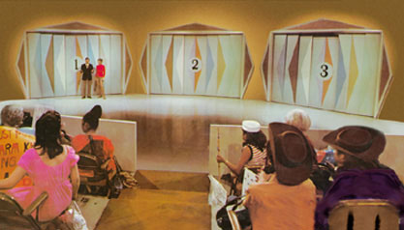
Monty Hall Webpages
http://www.letsmakeadeal.com
lec 13W.5

Slide 6
The Monty Hall Game
goats behind two doors
prize behind third door
contestant picks a door
Monty reveals a goat
behind an unpicked door
Contestant sticks, or switches
to the other unopened door
lec 13W.6

Slide 7
Switching is Better than Sticking!
But why? Intuition:
Imagine there are not 3 doors but 1000
Monty keeps opening doors and allowing you to switch
You stick 998 times
Now there are 2 doors left, one of which is the one you picked
Still want to stick?

Slide 8
Analysis: SWITCH strategy
2
L
1/18
1/2
1
1/2
3
L
1/18
1/3
2
1
3
1/3
W
1/9
1
3
1
2
1/9
W
1/3
W: 6/9 = 2/3
L: 6/18 = 1/3
1/3
W
1
3
1/9
1/3
1
1/3
1/2
1
L
1/18
2
1/3
2
1/3
1/2
3
L
1/18
1/3
3
1
1
W
1/9
3
1/3
1
W
1
2
1/9
Prize
location
1/3
2
1
1
W
1/9
1/3
1/2
2
L
1/18
3
1/2
1
Door you
Pick
L
1/18
Door Monty
Opens

Slide 9
really simple analysis
SWITCH strategy wins iff
prize door not picked:
L
Pr{switch wins}
yes
no
W
picks prize door
lec 13W.9

Slide 10
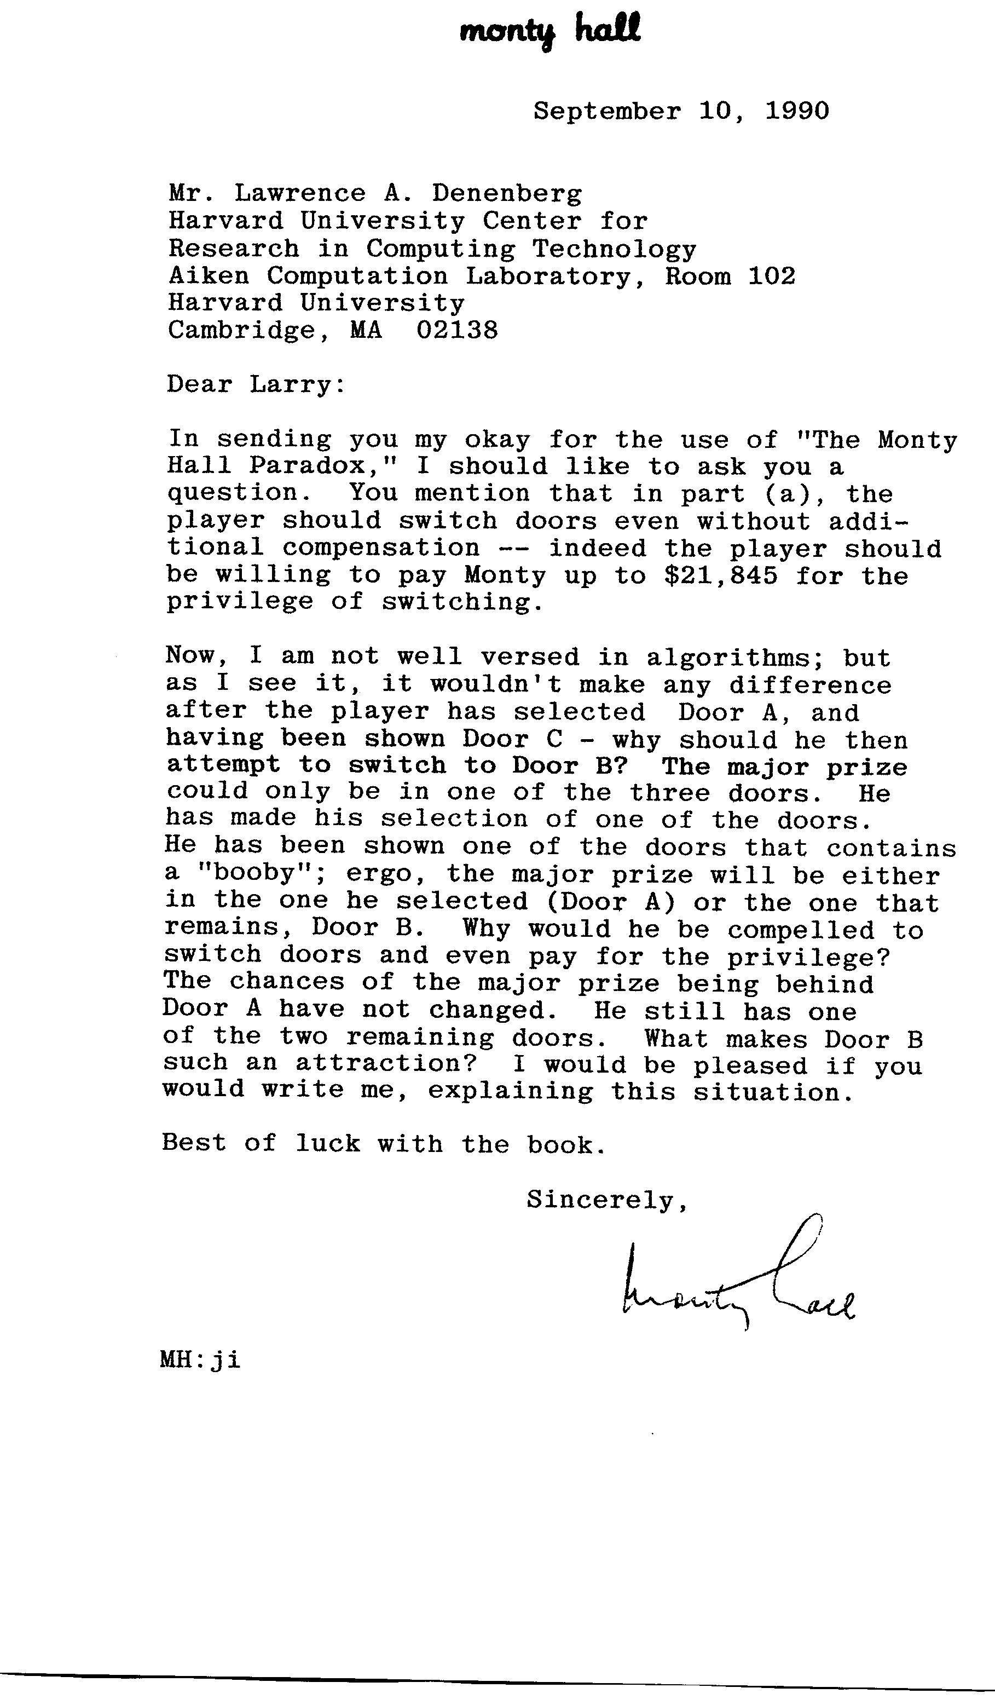
The Last Laugh

Slide 11
Finis
lec 13W.11

